Slide 1
FLEXPART for volcanic applications
M.D. Mulder, D. Arnold, C. Maurer
Questions? Write marie.mulder@zamg.ac.at

Slide 2
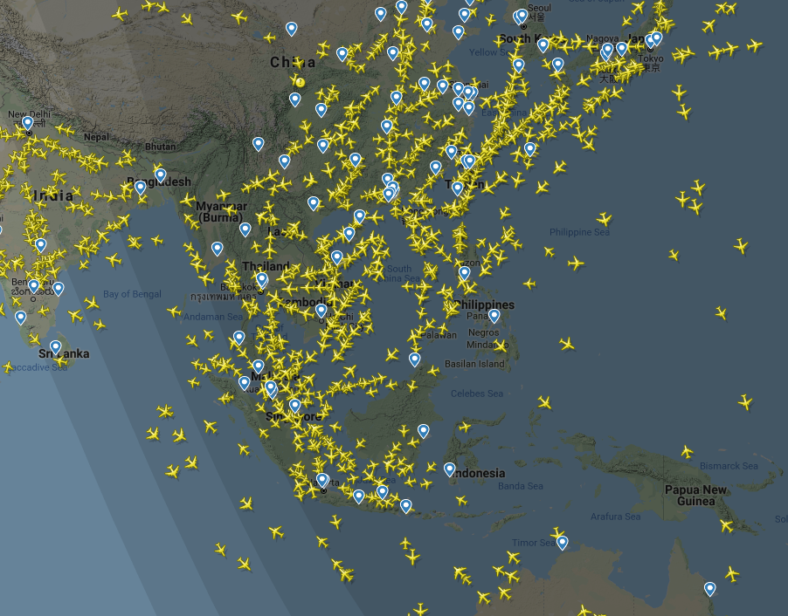
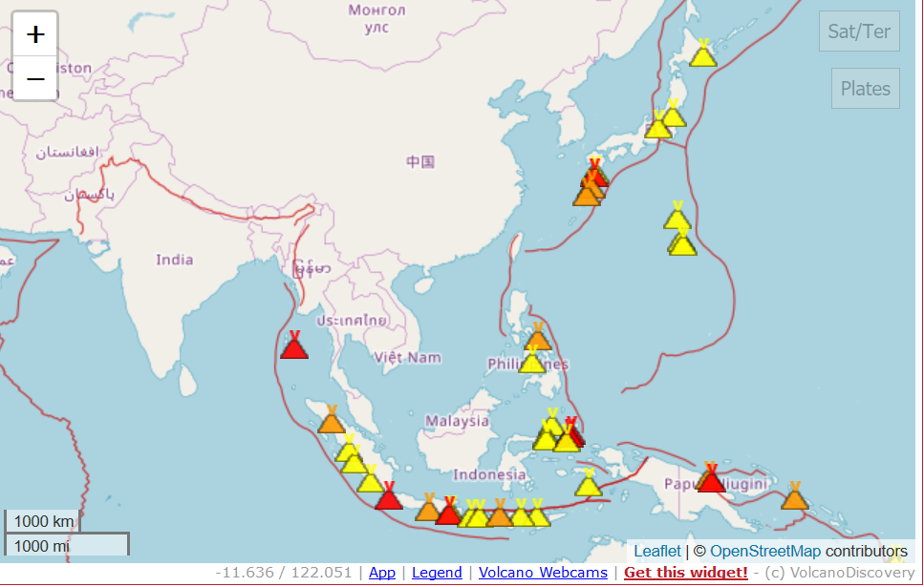
Introduction: are they important?
Flightradar information 12.12.2018 at 20:30 Local Time

Slide 3
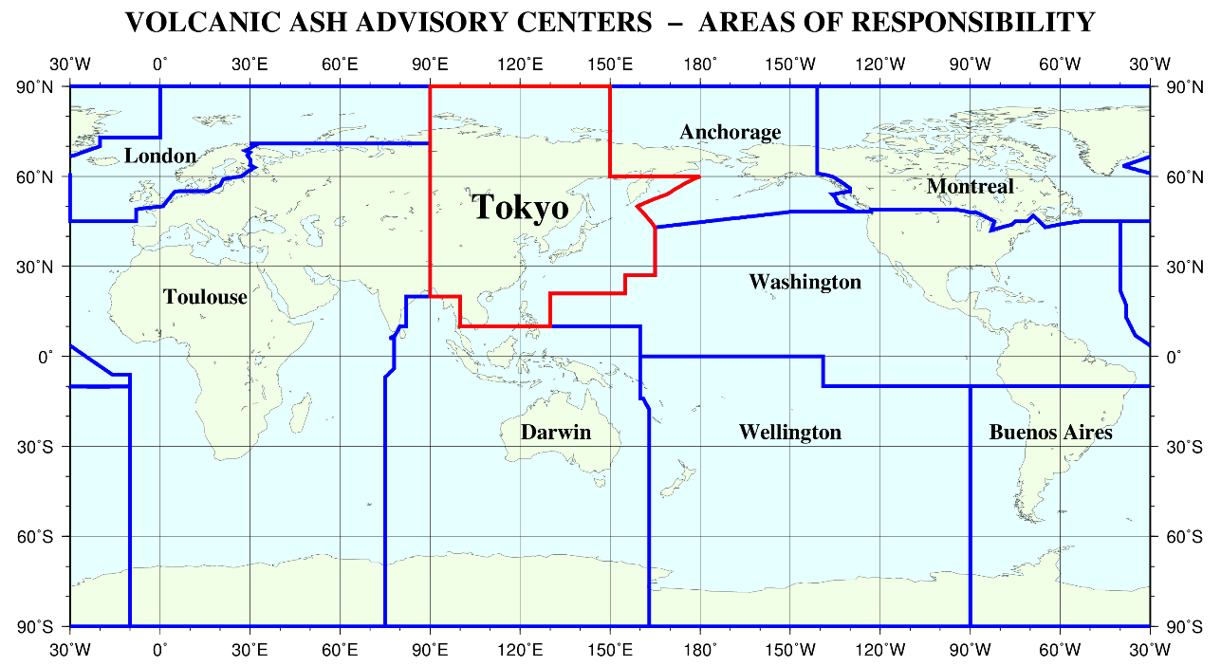
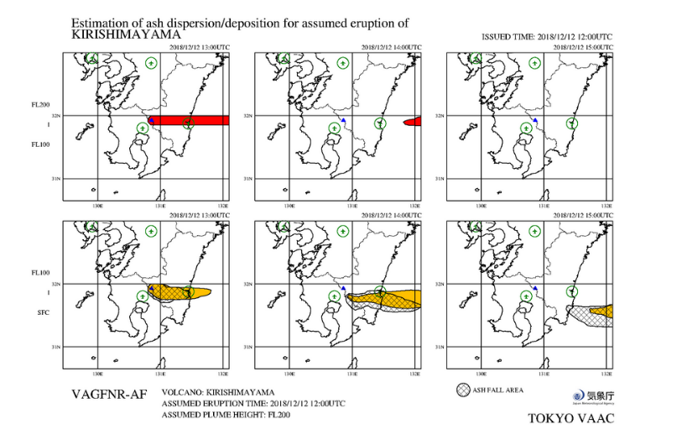
Introduction: VAACS
set up by the International Civil Aviation Organization (ICAO), an agency of the United Nations

Slide 4
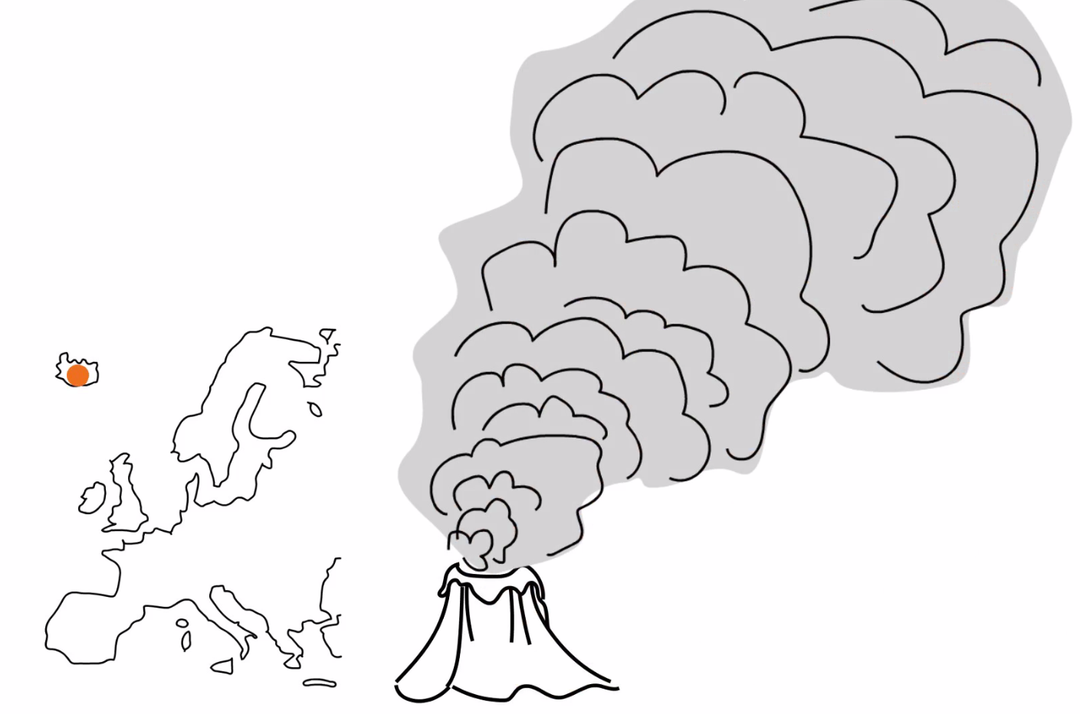
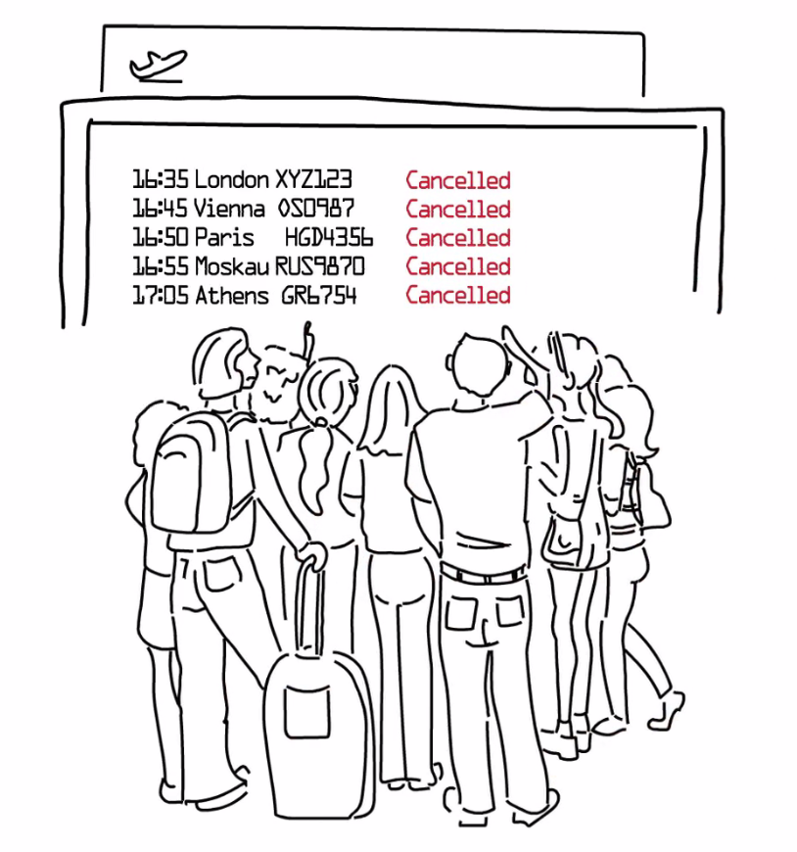
Introduction: Involvement of scientific community - EUNADICS
Eyjafjallajökull eruption April – May 2010
Due to the eruption of the Eyjafjallajökull in 2010, 100 000 flights were cancelled in total.

Slide 5
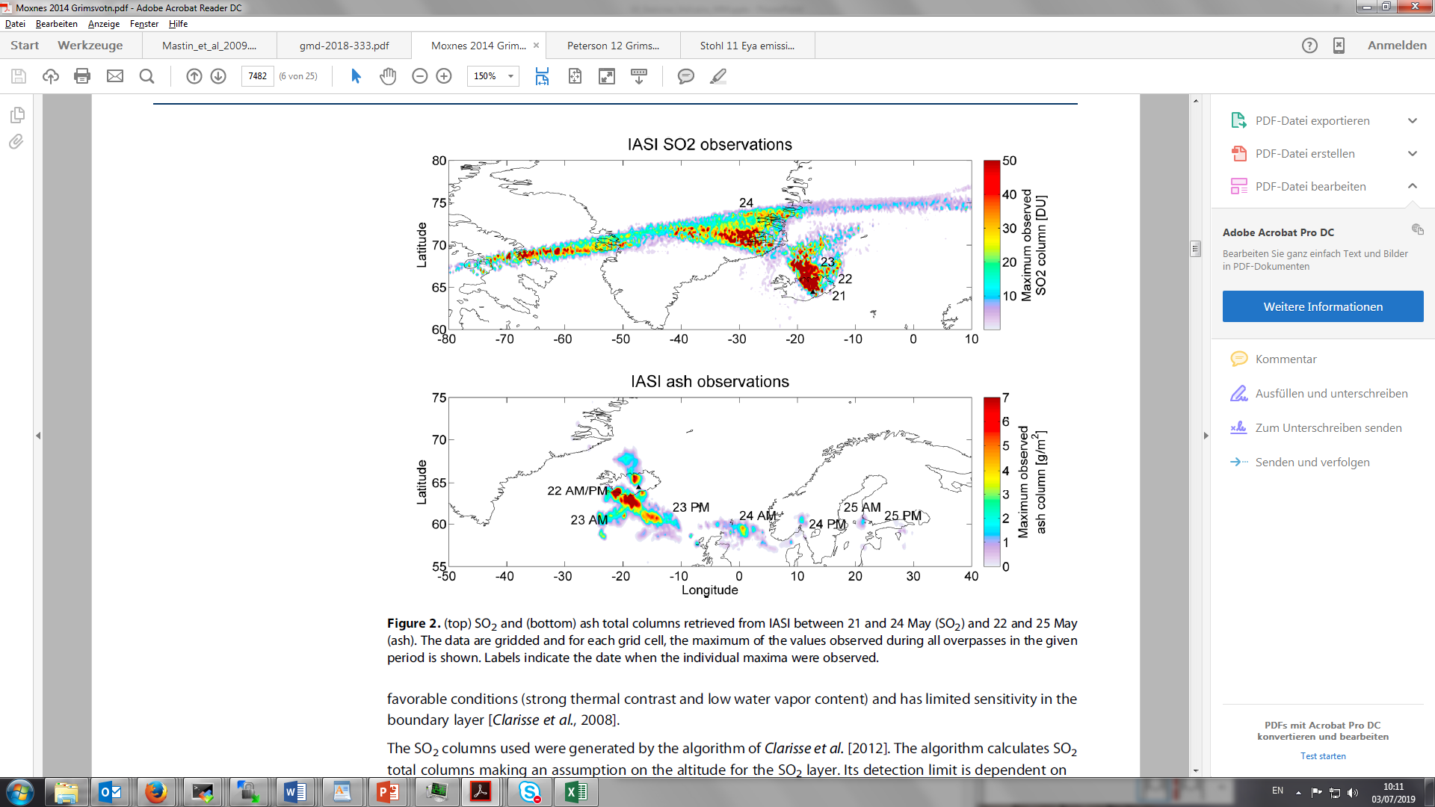
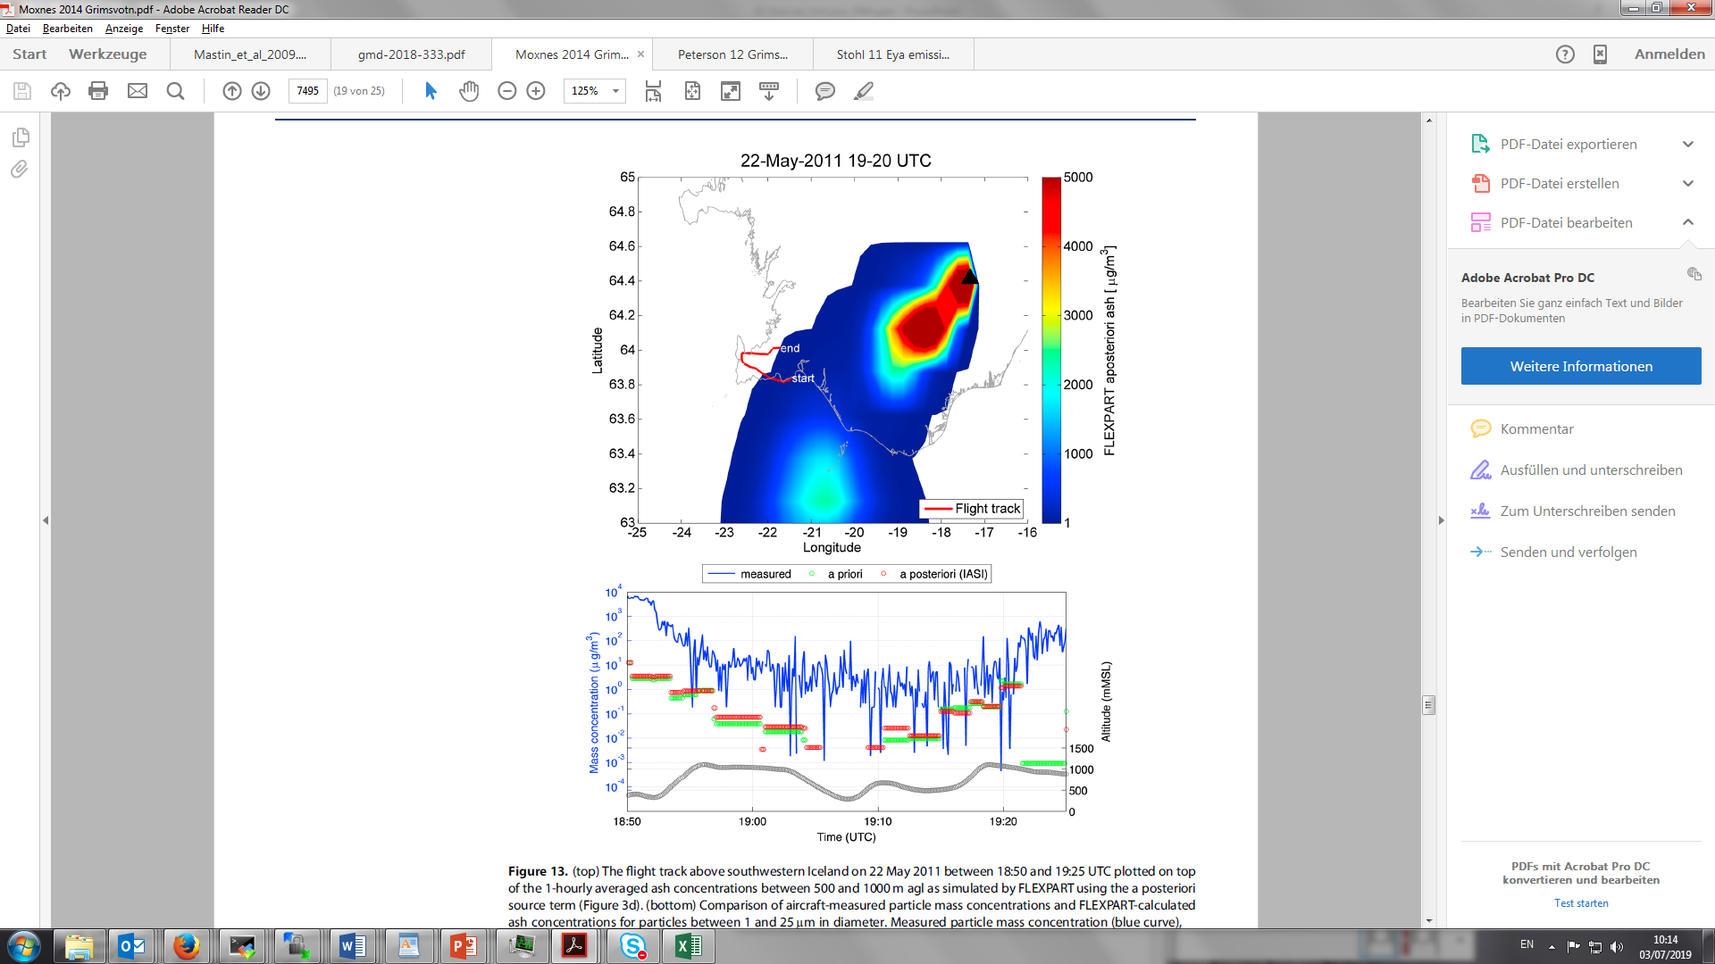
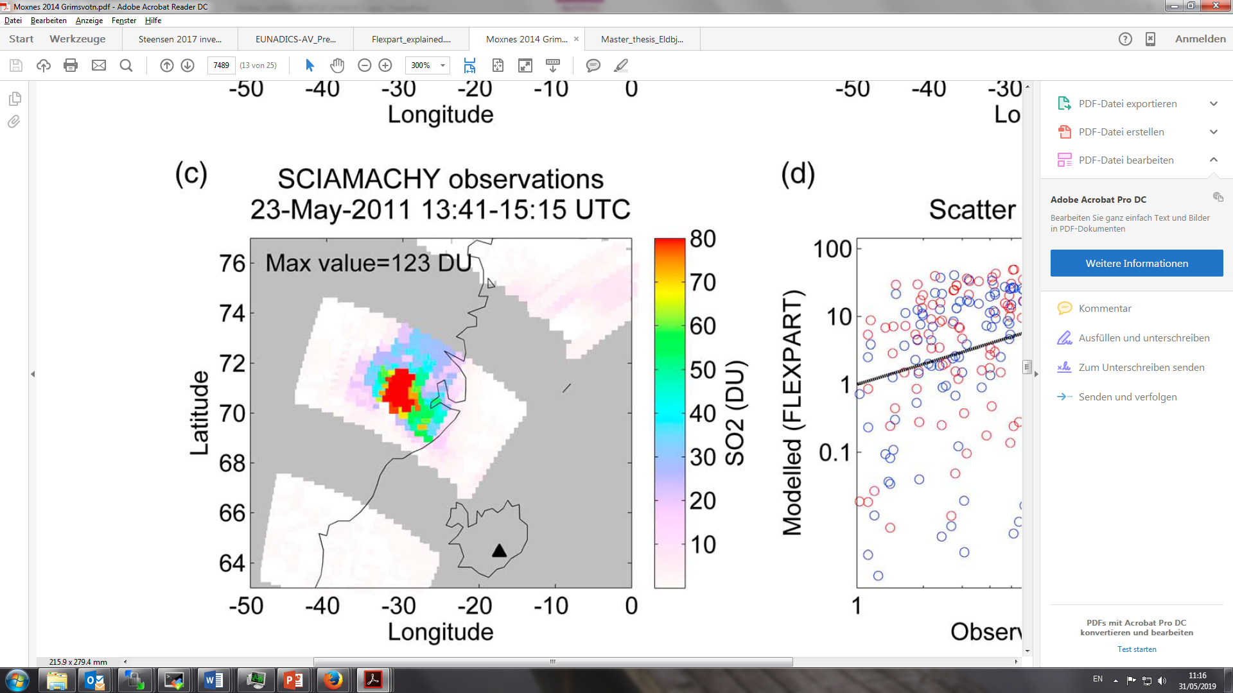
Grimsvotn remote sensing and flight data - can we use it in operational analyses?

Slide 6
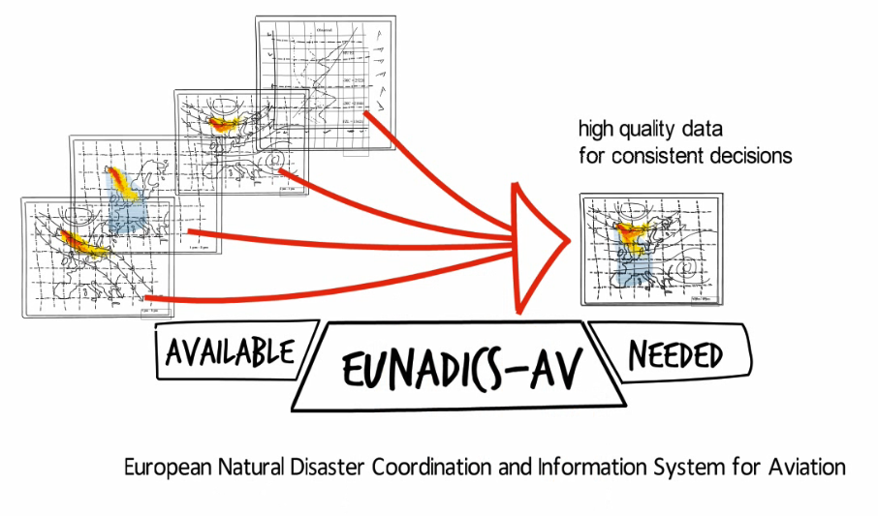
Introduction: EUNADICS
The project EUNADICS-AV undertakes to develop and test a unique system that helps to provide consistent and coherent information to aviation authorities, airlines and pilots in the event of a natural disaster affecting the airspace, which, if successful, would greatly enhance the resilience of one of the most critical infrastructures of the 21st century.

Slide 7
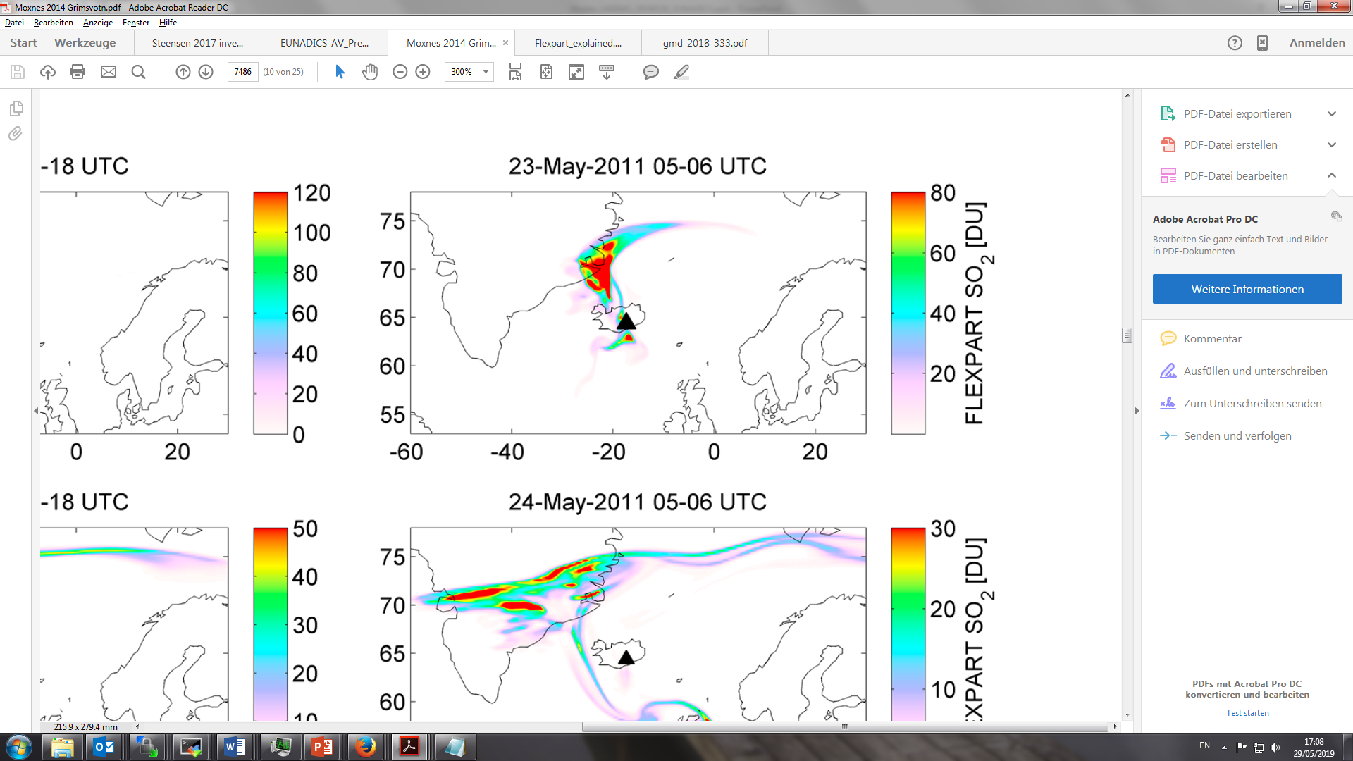
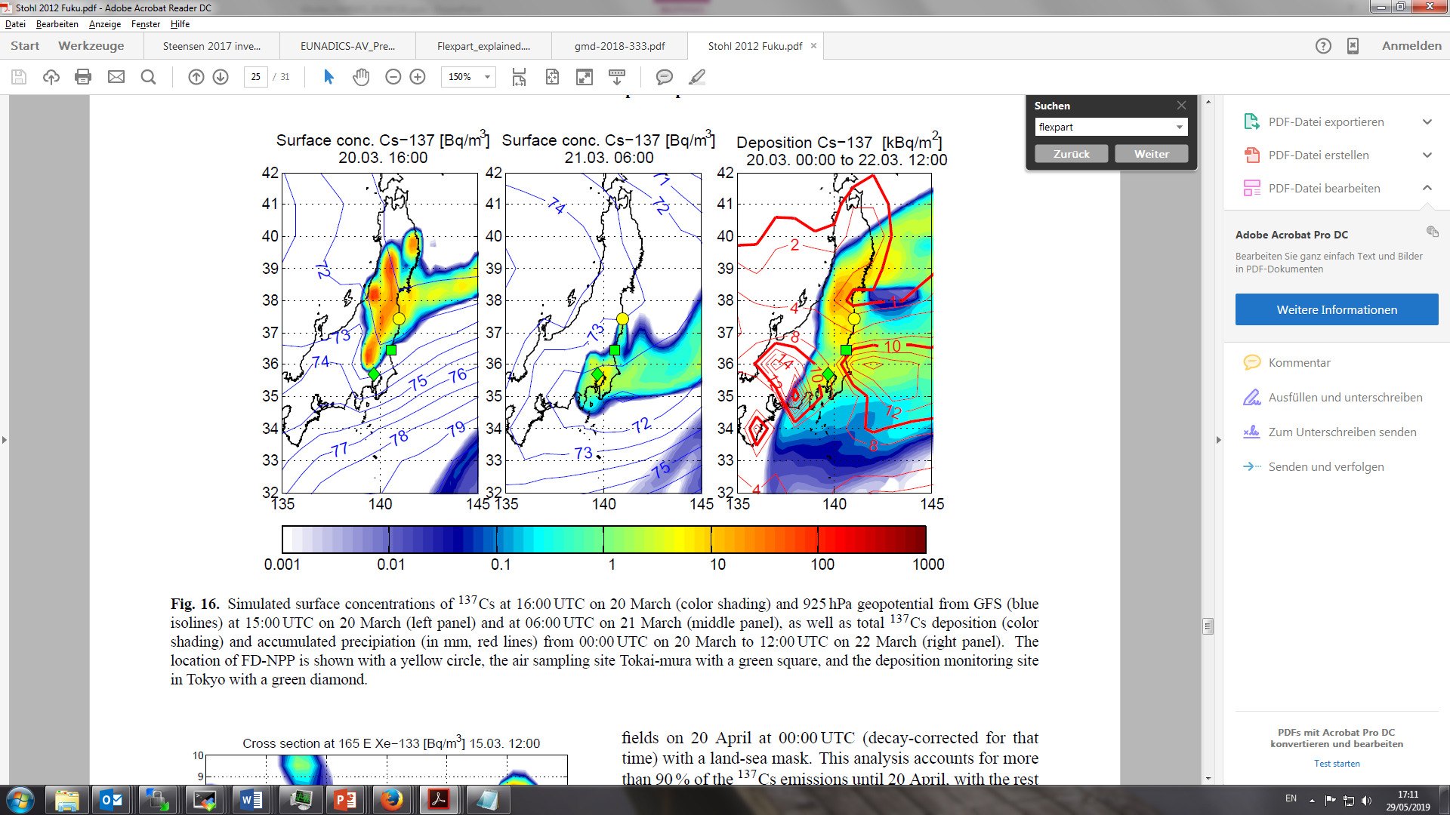
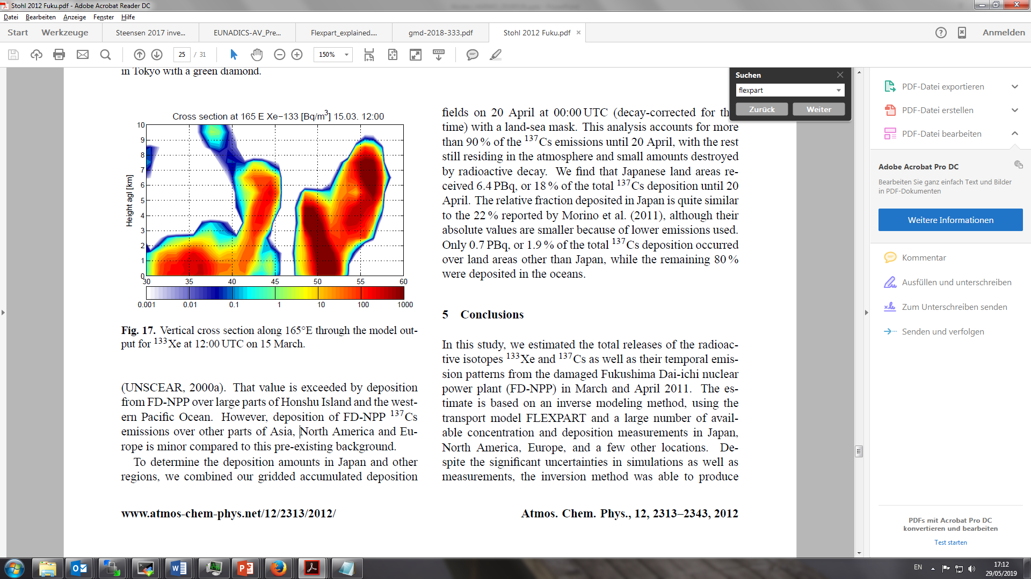
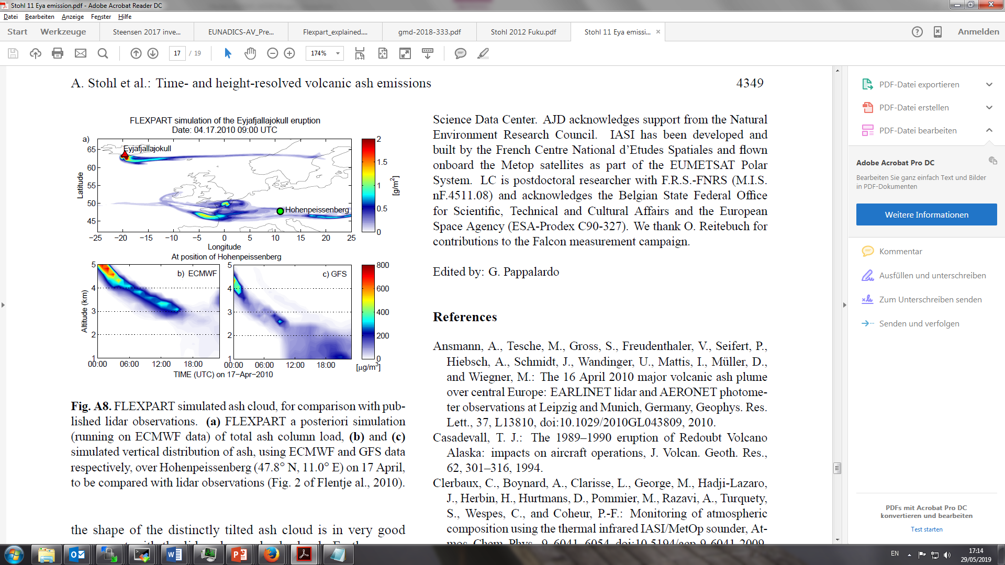
Introduction: Why we use FLEXPART?
(Flexible) Lagrangian Particle Dispersion Model is:
Fast
Parallelisation (with v9 trival, with v10 MPI)
Extensively tested (see literature)
Global developers community
Suitable for operational usage
And many more
Limitations:
No ash aggregation -> underestimation
Online chemistry only with climatological values; v10: preprocessed from Eulerian model
Flexpart.eu
Moxnes et al., 2014
Stohl et al., 2012
Stohl et al., 2012
Stohl et al., 2011

Slide 8
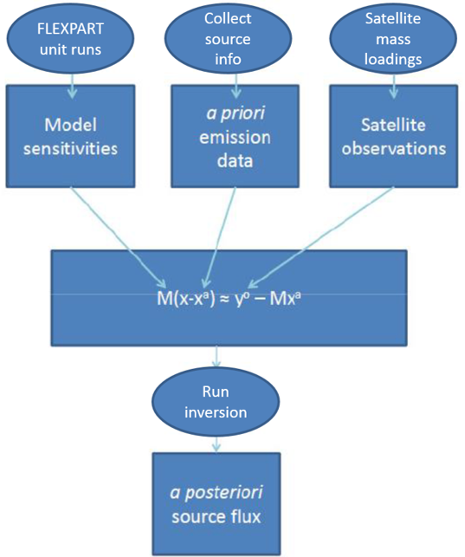
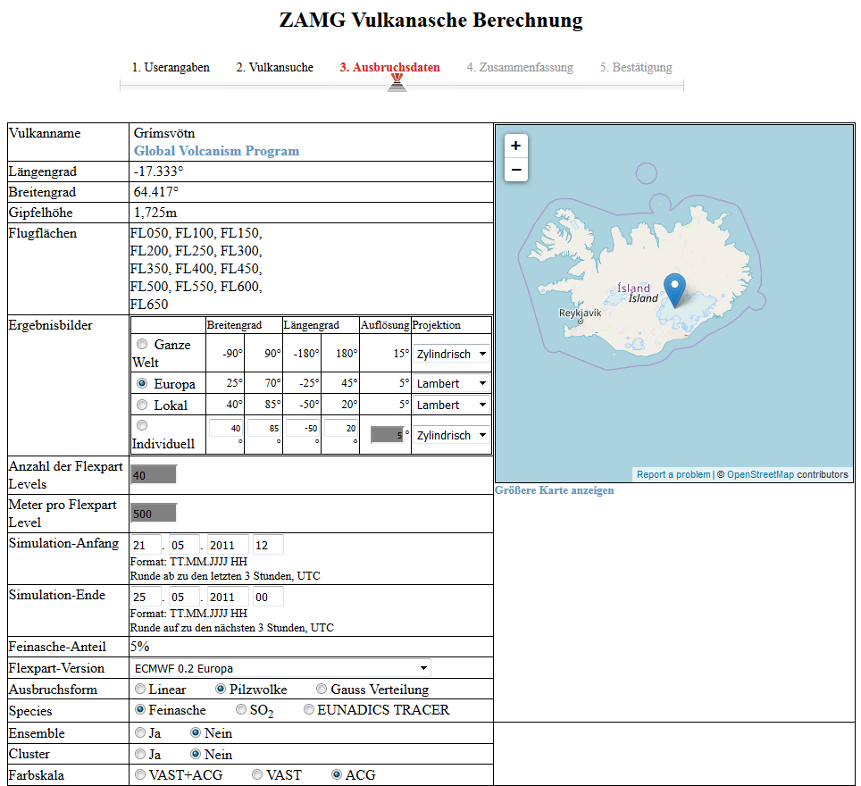
Methods: VAST ad-hoc routines + separate webtool
Before EUNADICS-AV, there was VAST:
Volcanic Ash Strategic initiative Team (ESA project 2012-2015, vast.nilu.no)
Inversion code estimates emission (x) by making the model match the observations (minimising the differences):
M = model sensitivities
xª = a priori
yº = sat obs
Adapted from: Kristiansen, N. I., Arnold, D., Stohl, A, VAST Technical Report: Procedures for volcano inversions using FLEXPART

Slide 9
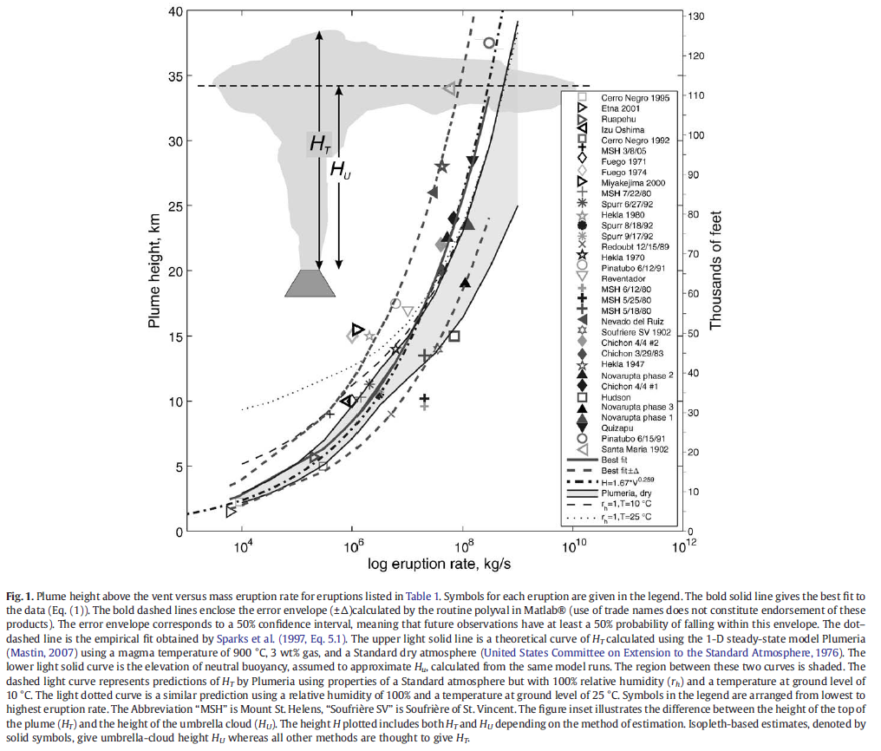
Methods: VAST ad-hoc routines + separate webtool
A PRIORI source term
What do we know?
Location
Plume height
What can we do:
Mastin et al., 2009 formula
34 eruptions
Best-fit line (bold solid line) with mass eruption rate Ṁ (kg/s) converted to volumetric flow rate V̇(m3 DRE* per second):
H = 2.00 V̇^{0.241}
Or PLUMERIA or other plume models
Estimate of size distribution
*Erupted volume V (dense-rock equivalent or DRE)
Mastin, L.G. et al., A multidisciplinary effort to assign realistic source parameters to models of volcanic ash-cloud transport and dispersion during eruptions, Journal of Volcanology and Geothermal Research (2009), doi:10.1016/j.jvolgeores.2009.01.008

Slide 10
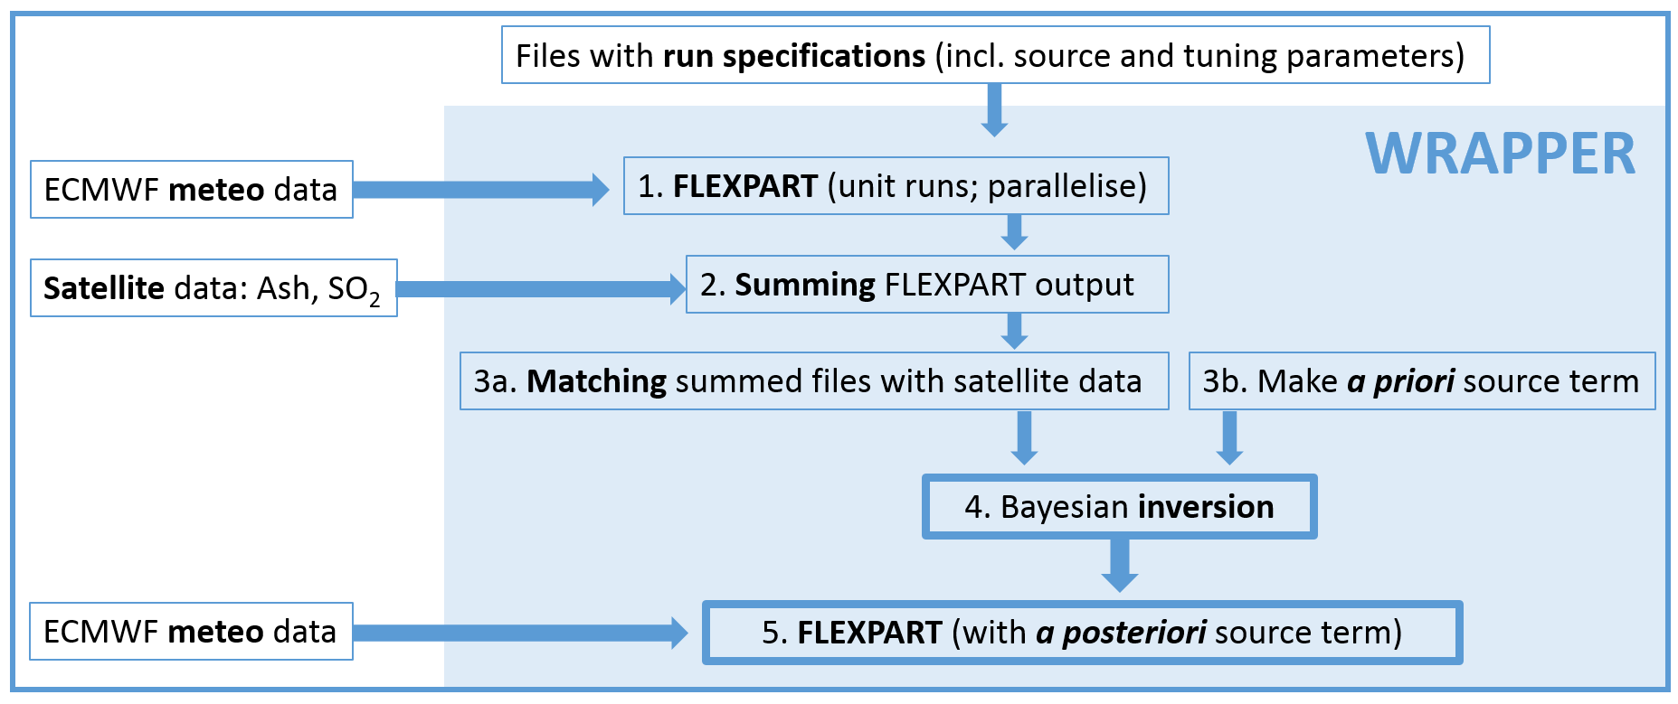
Methods: EUNADICS source term inversion at ZAMG
ZAMG HAZARD WEBTOOL (User input)
Products: plots and netCDF for WP6

Slide 11
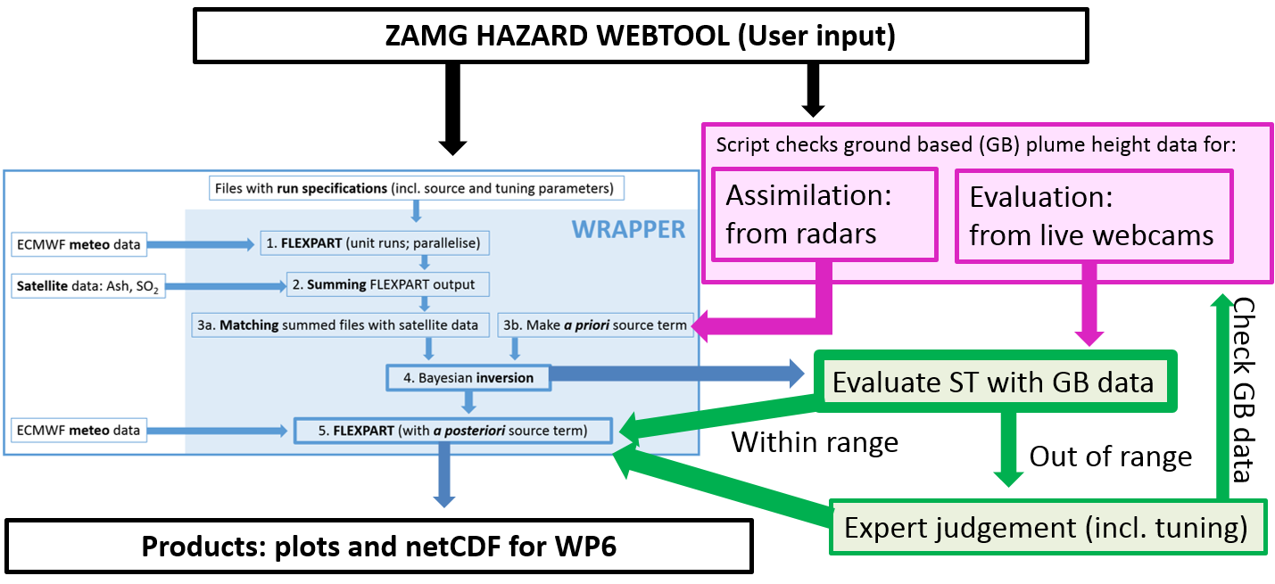
Methods: EUNADICS evaluation of vertical distribution of ash

Slide 12
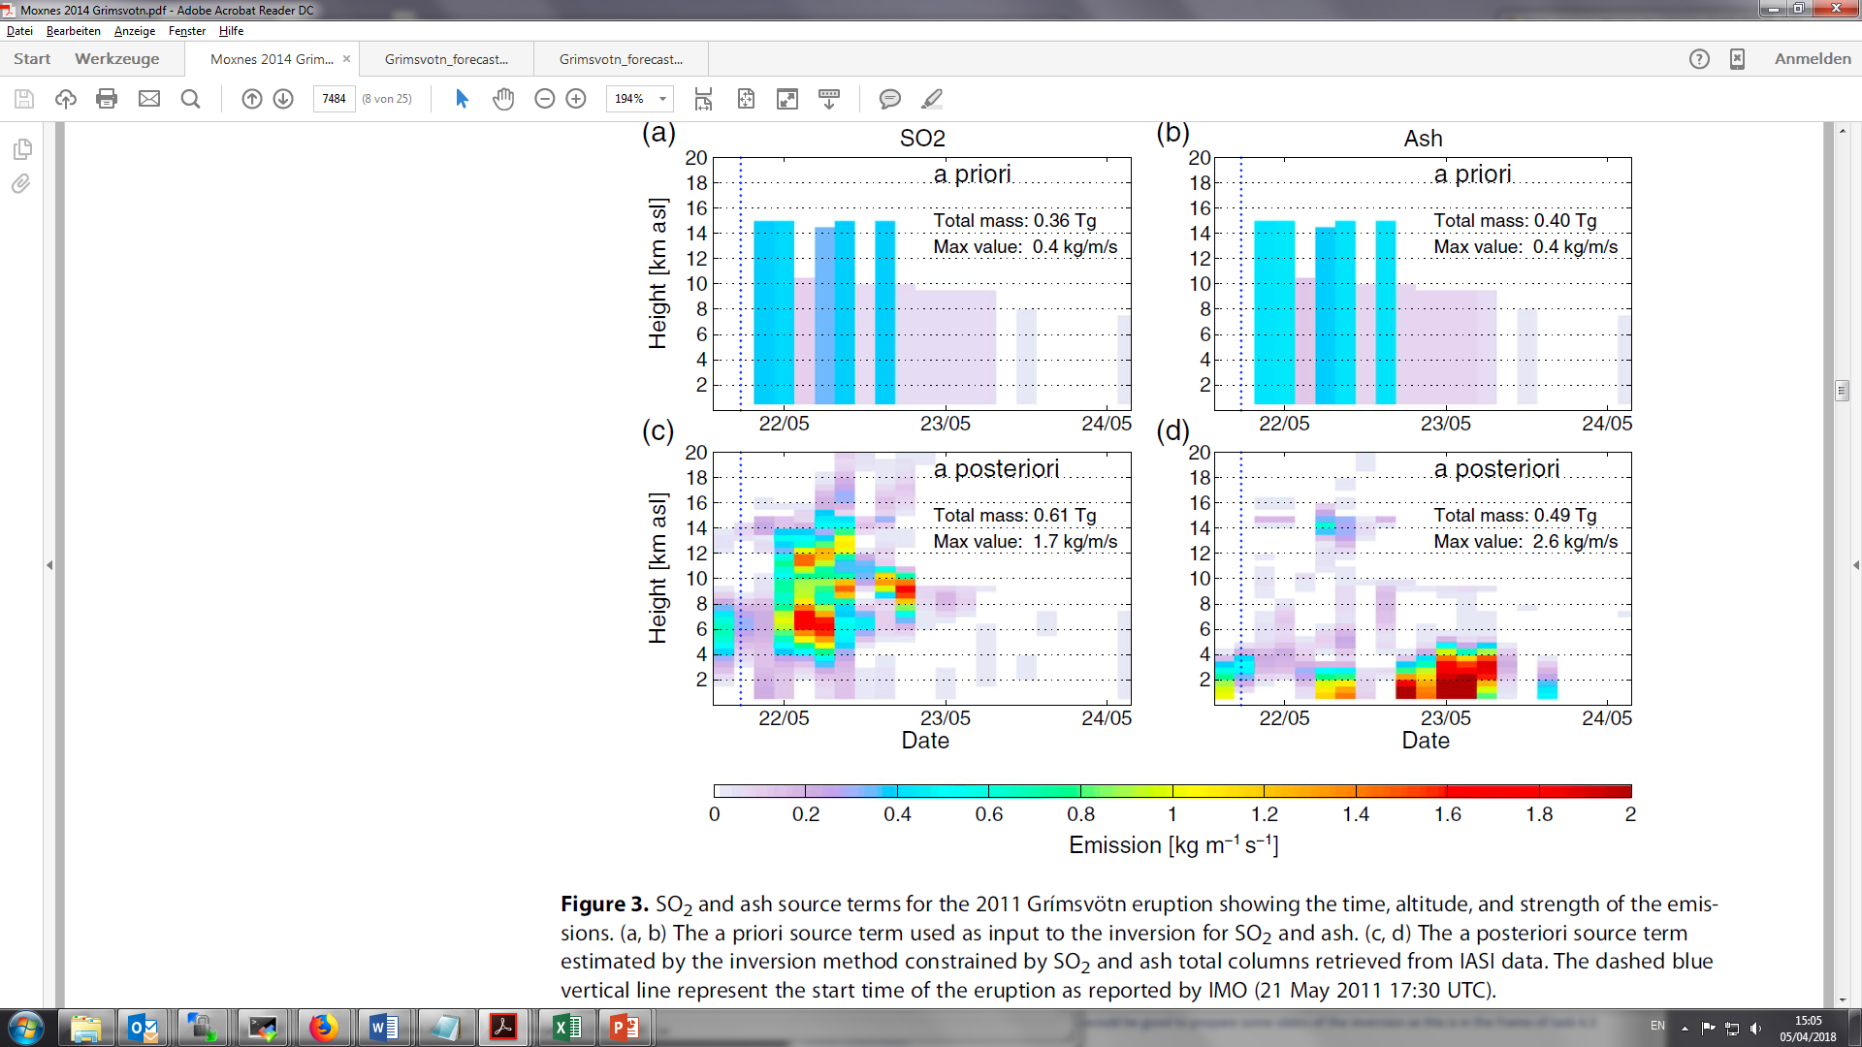
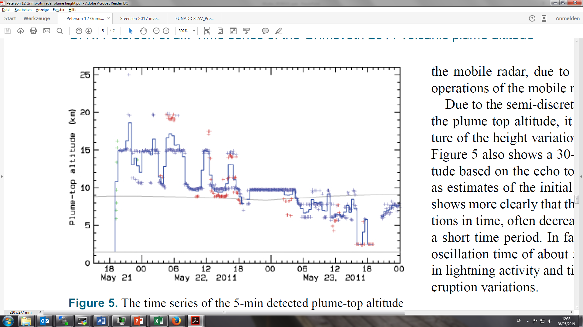
Methods: FLEXPART source-term and radar plume heights - Grimsvotn
Tropopause
Caldera
Time series of the 5-min detected plume-top altitude (km a.s.l.) from the:
C-band weather radar → go into a priori ST
X-band mobile radar → for evaluation
initial rise of the plume estimated from photographs
30-min average plume-top altitude of all the estimates is shown by the curve.
Moxnes, E. D., N. I. Kristiansen, A. Stohl, L. Clarisse, A. Durant, K. Weber, and A. Vogel (2014), Separation of ash and sulfur dioxide during the 2011 Grímsvötn eruption, J. Geophys. Res. Atmos., 119, 7477–7501.
Petersen, G. N., H. Bjornsson, P. Arason, and S. von Löwis (2012a), Two weather radar time series of the altitude of the volcanic plume during the May 2011 eruption of Grímsvötn, Iceland, Earth Syst. Sci. Data, 4(1), 121–127

Slide 13
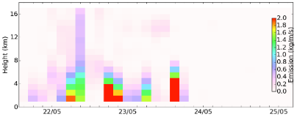
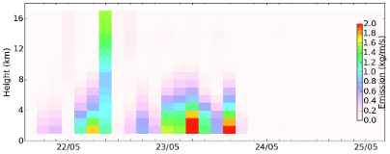
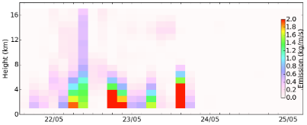
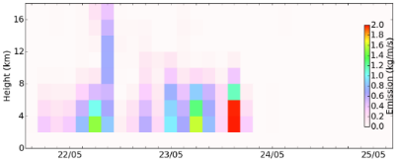

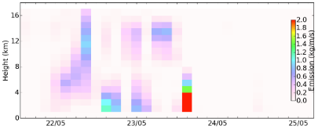
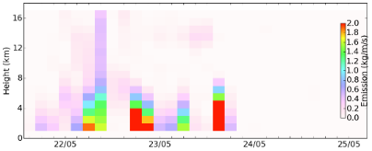
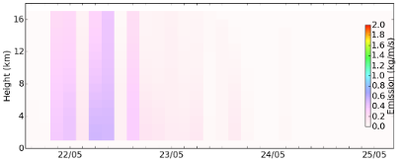
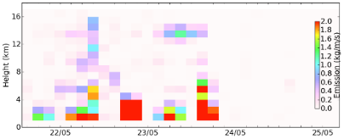
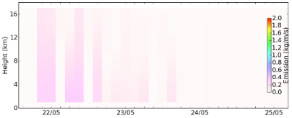
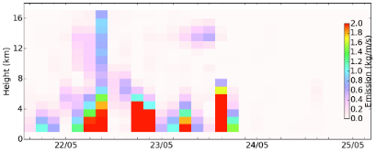
Sensitivity tests (incl. tuning)
1. Reference
2. Bin sizes 4 → 9
3. Longer ash life time
4. Halved vertical levels
5. ECMWF vent height
6. Meteo 0.5° → 1.0°
7. Particles/10
8. A priori: more weight
9. A priori: less weight
10. Model: less weight
11. Model: more weight

Slide 14
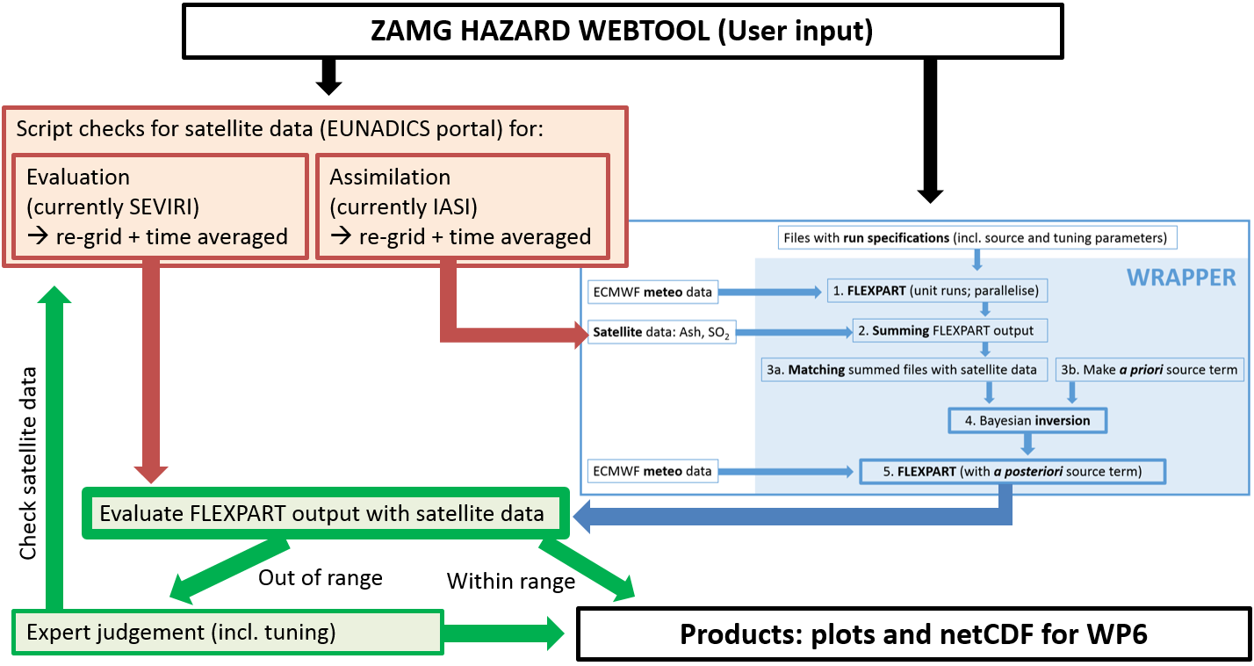
Methods: EUNADICS evaluation of horizontal distribution of ash

Slide 15
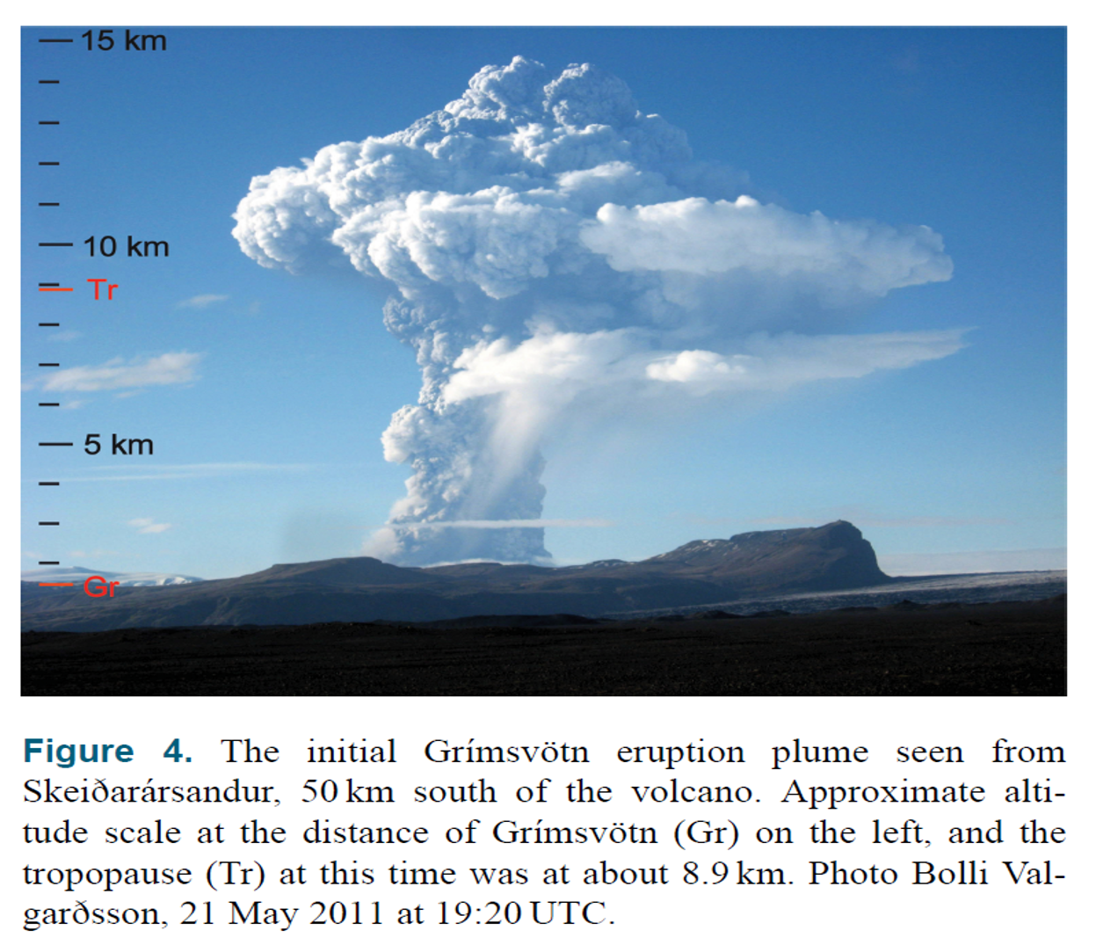
EXERCISE Grimsvotn eruption in 2011

Slide 16
Grimsvotn weather situation
large vertical wind shear in the atmosphere, also seen in the Skew-T, Log-p thermodynamic chart, located 250 km west of Grímsvötn volcano
→ south and then eastward transport of material emitted to low altitudes
Figure 1. ECMWF geopotential analysis for 21 May 12 UTC at (a) 1000 hPa and (b) 200 hPa; data taken from http://www.ecmwf.int. (c) Skew-T, Log-p chart at Keflavik radiosonde station located 250 km WSW of Grímsvötn Volcano, at 12 UTC on 21 May 2011 (data from University of Wyoming, http://weather.uwyo.edu/upperair/sounding.html).
→ northwestward transport of material emitted to high altitudes

Slide 17
Exercise: Grimsvotn
A PRIORI source term
What do we know?
Location
Plume height
What can we do:
Mastin et al., 2009 formula
34 eruptions
Best-fit line (bold solid line) with mass eruption rate Ṁ (kg/s) converted to volumetric flow rate V̇(m3 DRE* per second):
H = 2.00 V̇^{0.241}
Or PLUMERIA or other plume models
Estimate of size distribution
*Erupted volume V (dense-rock equivalent or DRE)
Mastin, L.G. et al., A multidisciplinary effort to assign realistic source parameters to models of volcanic ash-cloud transport and dispersion during eruptions, Journal of Volcanology and Geothermal Research (2009), doi:10.1016/j.jvolgeores.2009.01.008

Slide 18
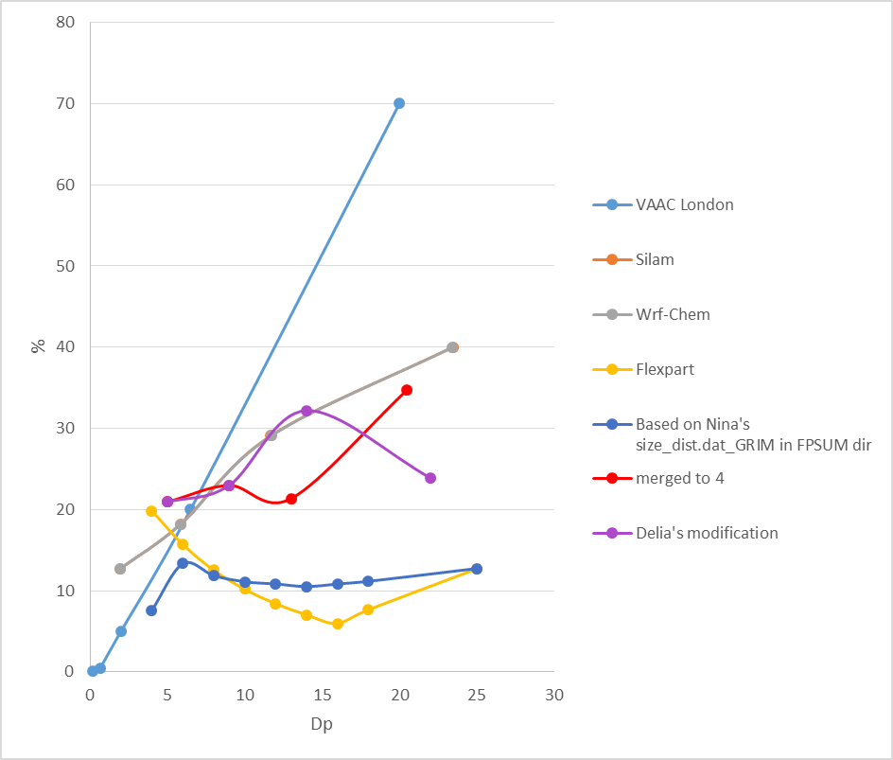
Methods: size bins and distribution
WRF-chem
Range | Median | %
0 - 3.9 | 1.950 | 12.727
3.9065 - 7.8125 | 5.860 | 18.182
7.8125 - 15.623 | 11.718 | 29.091
15.623 - 31.25 | 23.437 | 40
Flexpart
Median | %
4 | 0.1985
6 | 0.157
8 | 0.1253
10 | 0.1018
12 | 0.084
14 | 0.0703
16 | 0.0596
18 | 0.0766
25 | 0.127
For this exercise we will use the size distribution with 4 bins, and a shortened source term.

Slide 19
Exercise: Grimsvötn eruption
[make dir volc with link to FLEXPART exe]
Dates: 2011052118 – 2011052218
Domain: 40-70N 0-30W
Copy RELEASES and SPECIES from exercise_material_volc/volc/options
Before running check: output units, AVAILABLE in met dir?
For pathnames:
/path/to/met/data/ecmwfData_0.5_Grimsvoetn/
/path/to/met/data/ecmwfData_0.5_Grimsvoetn/AVAILABLE
Run with A priori source term with 4 species (with diameters 5, 9, 13, 21 µm) of ash

Slide 20
&COMMAND
LDIRECT= 1
IBDATE= 20110521
IBTIME= 180000
IEDATE= 20110522
IETIME= 180000
LOUTSTEP= 3600
LOUTAVER= 3600
LOUTSAMPLE= 900
ITSPLIT= 99999999
LSYNCTIME= 900
CTL= -5.0000000
IFINE= 4
IOUT= 1
IPOUT= 0
&OUTGRID
OUTLON0= -80.0000000 ,
OUTLAT0= 40.0000000 ,
NUMXGRID= 560,
NUMYGRID= 160,
DXOUT= 0.250000000 ,
DYOUT= 0.250000000 ,
OUTHEIGHTS= 20000.0000 ,
LSUBGRID= 0
" LCONVECTION= 1"
" LAGESPECTRA= 0"
IPIN= 0
IOUTPUTFOREACHRELEASE= 1
IFLUX= 0
" MDOMAINFILL= 0"
IND_SOURCE= 1
IND_RECEPTOR= 1
MQUASILAG= 0
NESTED_OUTPUT= 0
LINIT_COND= 0
SURF_ONLY= 0
CBLFLAG= 0

Slide 21
Exercise plotting
Copy makePLOTFLEXwithST.py, read_header.py and read_grid.py from exercise_material_volc/volc/
Start plotting:
./plot_FLEX_binary.py output_ecm/ False ash1,ash2,ash3,ash4 0 0 20110522180000 lcc
See figure:
display figure_name

Slide 22
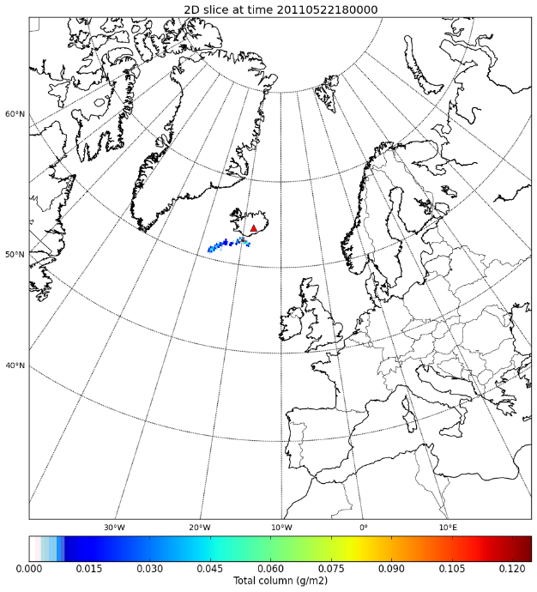
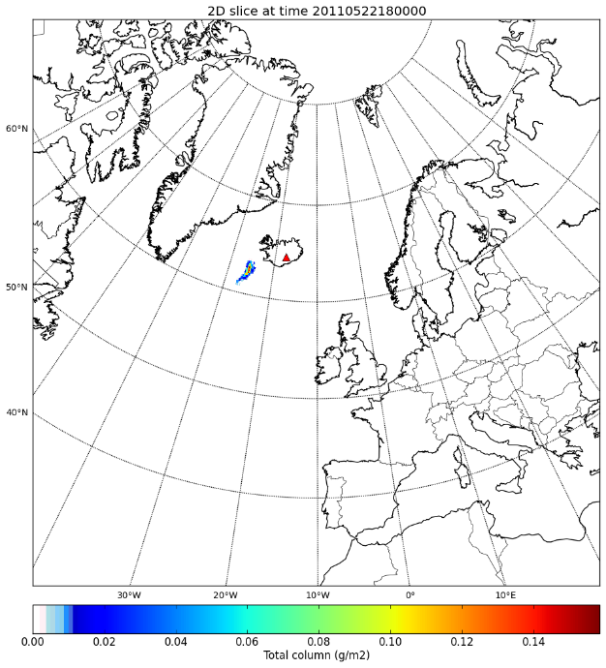
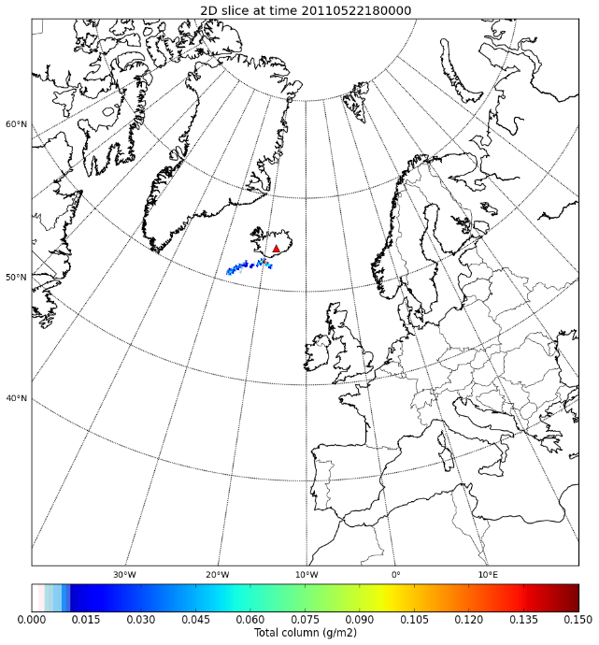
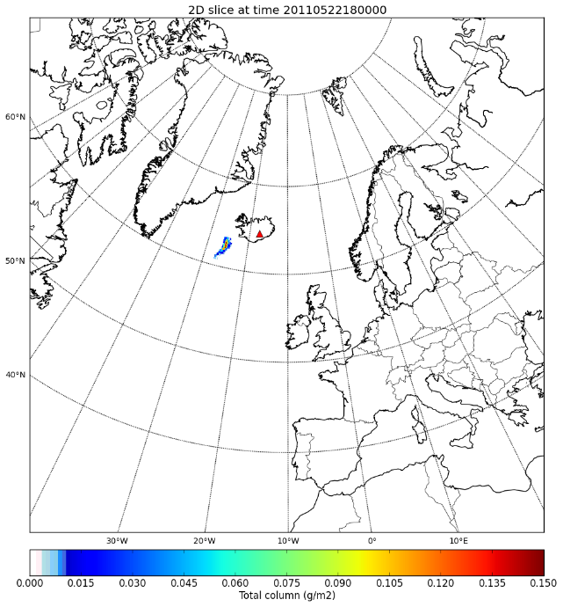
ECMWF:
NCEP:
With same colobar max (vmax):

Slide 23
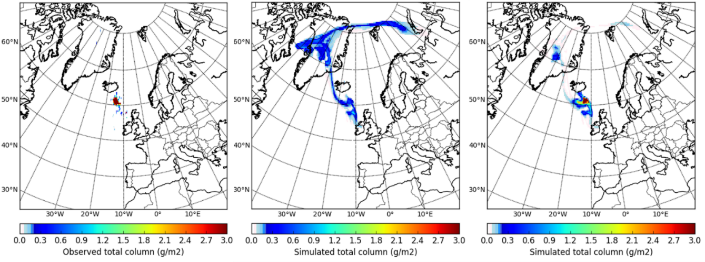
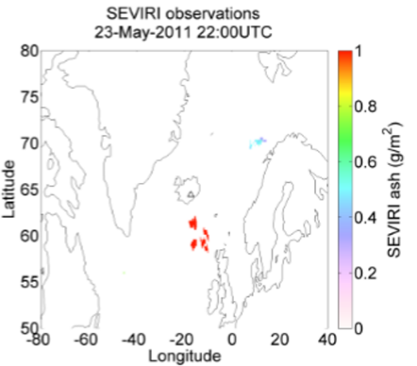
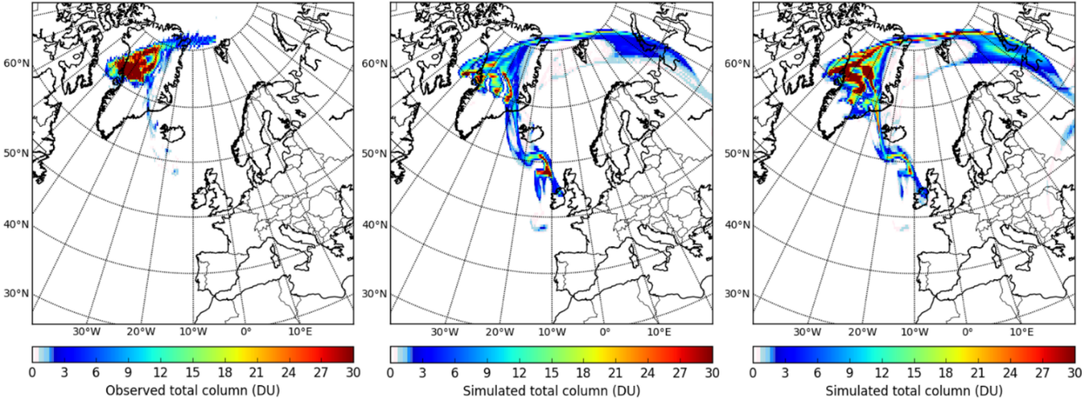
Results for May 23, 22 UTC: IASI, a priori ST, a posteriori ST, SEVIRI (when running with the source term for the entire eruption )
IASI
A priori
A posteriori

